Slide 1

Why do we perform an ultrasound neuroopthalmological examination?
Ocular and Orbital Ultrasound
Piergiorgio Lochner

Slide 2
No disclosures related to this presentation

Slide 3
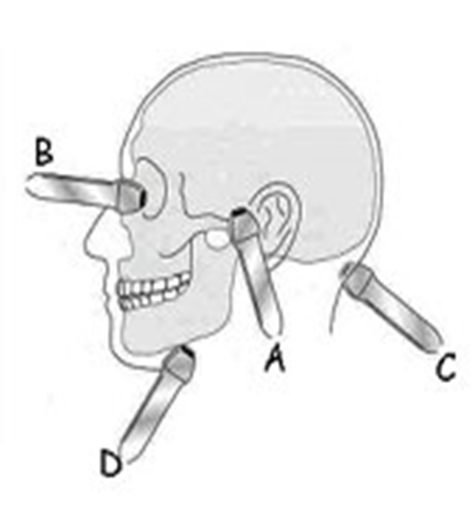
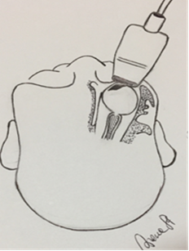
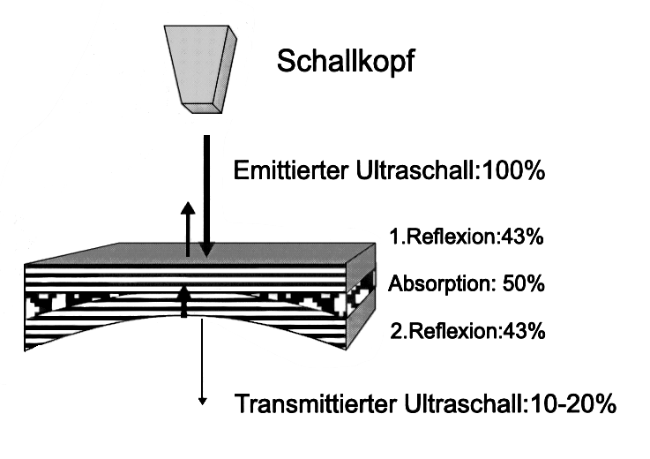
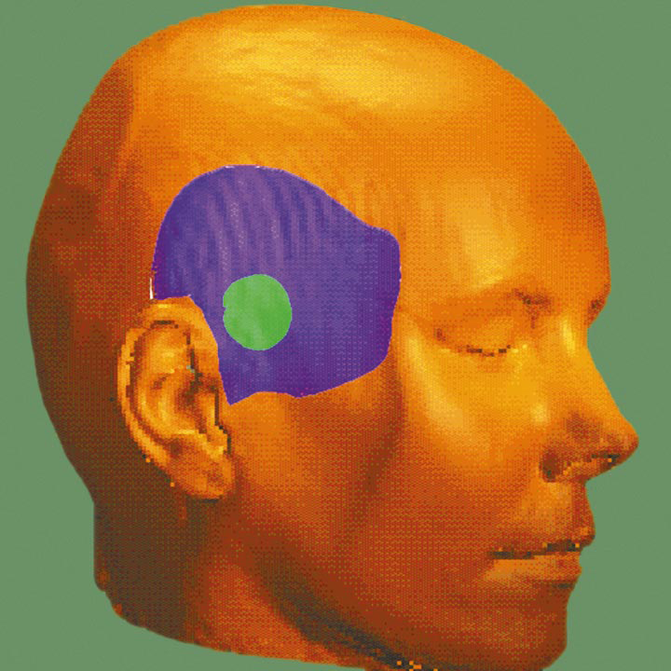
Transorbital ultrasound: a window to the brain?

Slide 4


PERSPECTIVE OF EYES

Slide 5
EXAMINATION TECHNIQUE

Slide 6
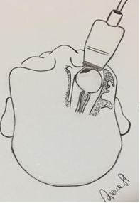
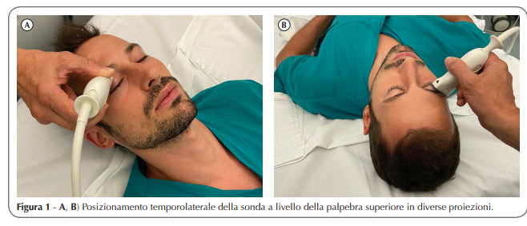
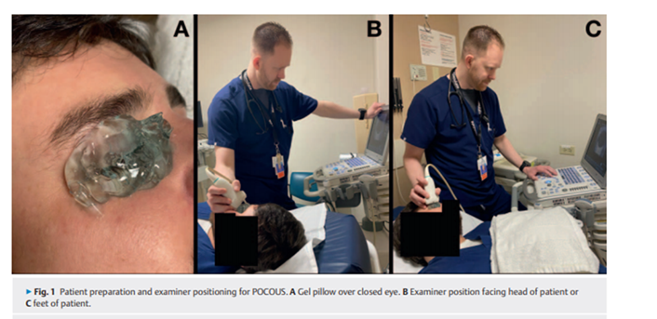
POSITION OF THE PROBE AND PROTOCOL OF EXMINATION
Hoffmann B et al. Emergency Ocular Ultrasound Ultraschall in Med 2020
Notes:
Ultrasound settings should be adjusted to proper near field examination (depth and focus adjustement)
-The probe is placed on to the closed upper lateral eyelid on a transversal plane
the patient is asked to look straight ahead or to keep his gaze towards the ceiling

Slide 7
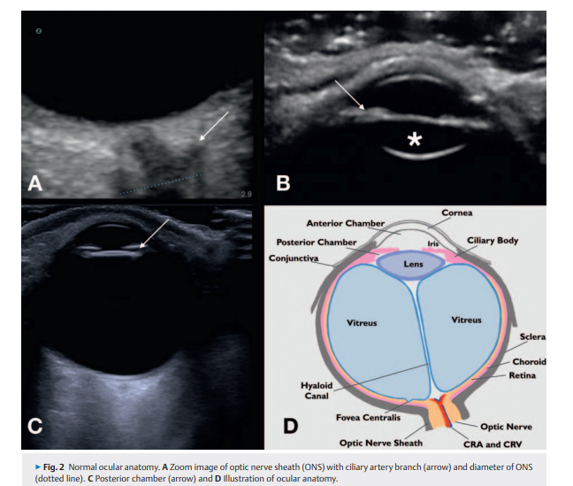

Slide 8
A-D (A 3.5, B 5, C 6.6, and D 10 MHz):
Ultrastructures of the optic nerve and its sheaths are clearly defined
Lochner P et al. J Neuroimaging 2019

Slide 9
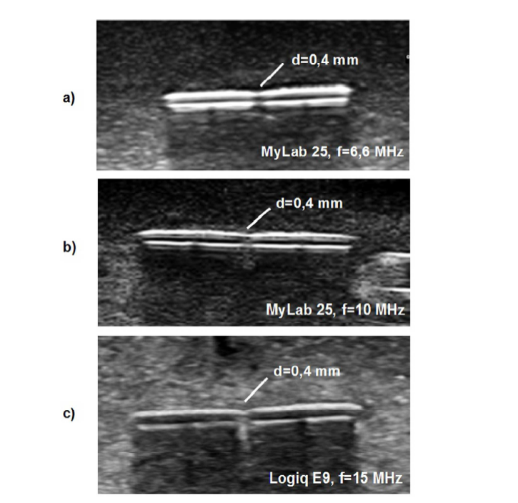
Simulation and Experimental Characterization of Lateral Imaging
Resolution of Ultrasound Systems and Assessment of System
Suitability for Acoustic Optic Nerve Sheath Diameter
Measurement
Phantom consisting of PVC strips at a distance of d = 0.4 mm
Lochner P et al. J Neuroimaging 2019

Slide 10
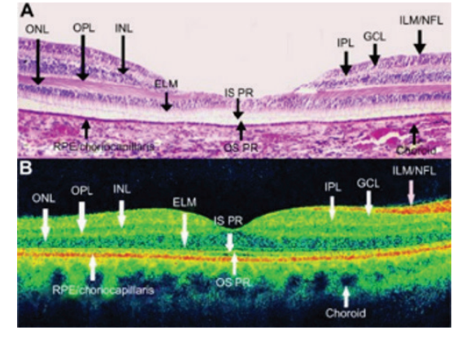
OCT versus TOS
 | OCT | TOS
depth resolution | 5 µm | lateral axial spatial resolution 0.4 mm
acquisition speed | 400 000 A-scans/second, 4–6 | minutes
Advantages | shorter scanning time and reduced movement artefact | Better and proper visualisation of all orbital structures

Slide 11
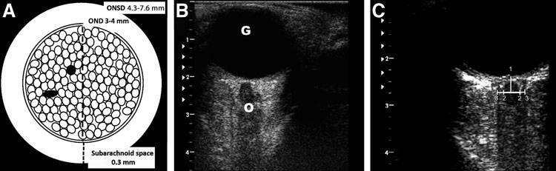
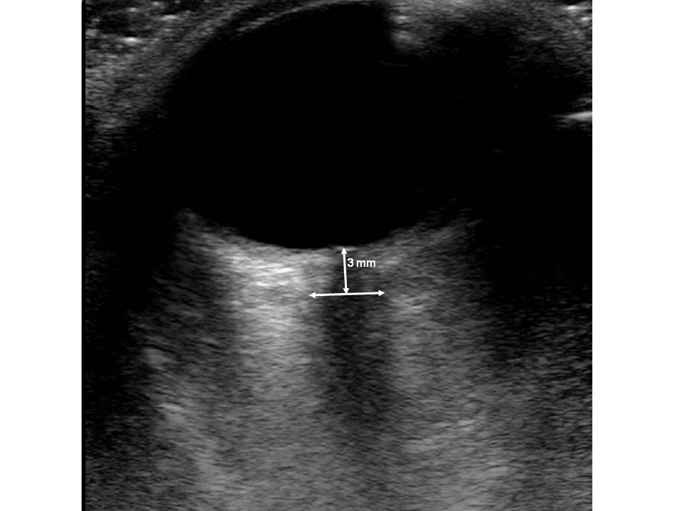
B-MODE-DEPICTION OF OPTIC NERVE AND OPTIC NERVE SHEATHS
High frequency linear probes (>7.5 MHz)
mechanical Index (MI) adjusted≤ 0,3
Well-defined, longitudinal compact structure, hypoechogenic nerve fibers (o)
Hyperechogenic borders due the trabecolar structure and is surrounded by dura mater and periorbital fat (Killer HE et al. Br J Ophthalmol 2011)
Notes:
Am liegenden Patienten. Auf das geschlossene obere laterale Augenlid wird Gel aufgetragen und die Schallsonde in transversaler
Ebene aufgesetzt. Zur besseren Standardisierung und zur Vermeidung von Bulbusbewegungen kann der Patient aufgefordert
werden, den Blick in Richtung seiner Füße zu halten.
echoarme Sehnerv
umgeben von einer echoreichen Struktur, der liquorgefüllten Sehnervenscheide
mögliche
Gefährdung des Auges, insbesondere der Linse
Sendeleistung auf einen mechanischen Index zwischen 0,1
und 0,3 reduziert werden.
The anterior chamber of the eye and the vitreous body show up as an anechoic structure, whereas the lens shows up as a thin anechoic line.
The anterior part of the optic nerve and the optic disc are shown in their longitudinal course in the axial plane behind the eyeball. The optic nerve is shown in a longitudinal view and appears hypoechoic
The subarachnoid space between the optic nerve and the dura mater also appears hyperechoic due to reflections from the trabecular structure

Slide 12
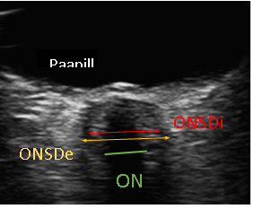
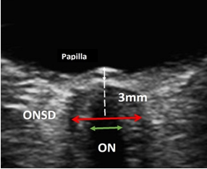
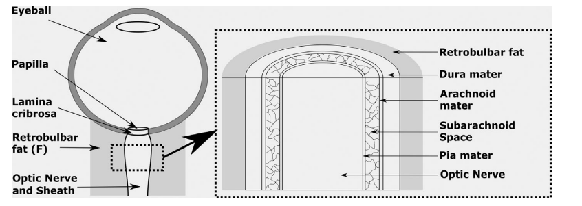
IMPROPER NON STANDARD AND STANDARD TECHNIQUE
Ertl M et al. Optic nerve sheath diameter assessment by neurosonology J Neuroimaging 2021

Slide 13
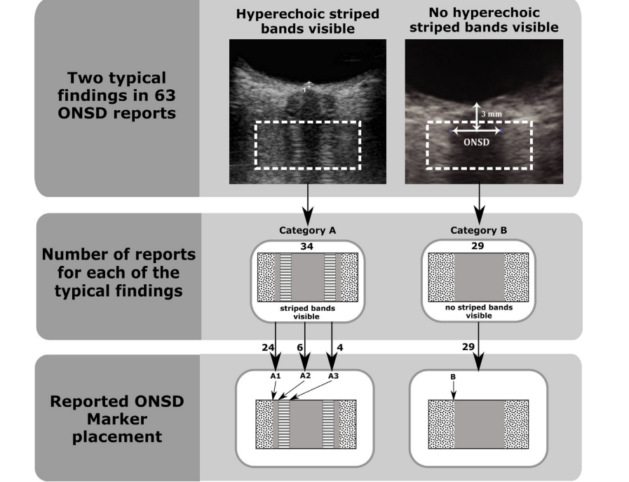
Ertl M et al. Optic nerve sheath diameter assessment by neurosonology J Neuroimaging 2021

Slide 14
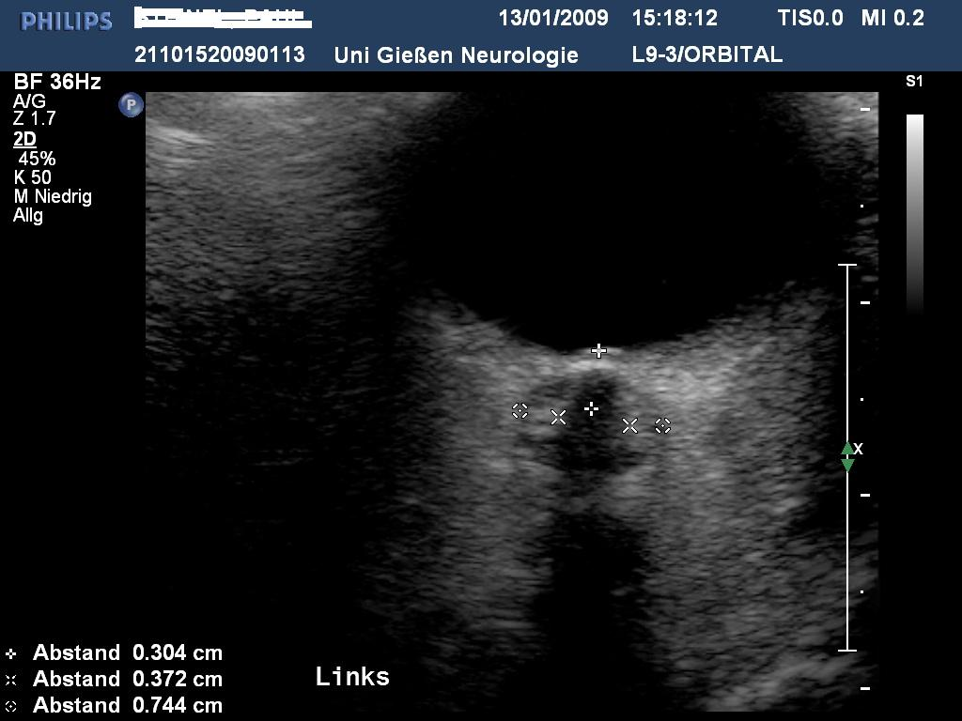
IMPROPER POSITION OF OPTIC NERVE
14
Notes:
verdeutlichen

Slide 15
INTER- INTRAOBSERVER RELIABILITY AND NORMAL VALUES OF ONSD
Healthy subjects: mean ONSD: 5.4±0.6 mm (range 4.3-7.6 mm)
Intra-Rater-Reliability: 0,92 right und 0,97 left
Inter-Rater-Reliability: 0,81 right und 0,84 left
No correlation with Age, body mass index or gender
1) Lochner P et al. J Neuroimaging 2012; 2) Lochner P et al. J Ultrasound 2016

Slide 16
DIFFERENT NORMAL MEAN VALUE OF ONSD

Slide 17
MEAN VALUES OF ONSD IN ADULTS
ONSD 4.5-5 mm **(Guthoff R 1991,Hansen HC 1994 and Ossoinig KC 1993): A Mode-B mode.
Geeraets 5.08 ± 0.52 mm in healthy volunteers
Moretti et al.: sedated patients 4.8 +/-0.5 mm patients with normal ICP
Moretti et al. 2009 Neurosurg. Anesthesiol
Geeraets et al Intensive Care Med 2007

Slide 19
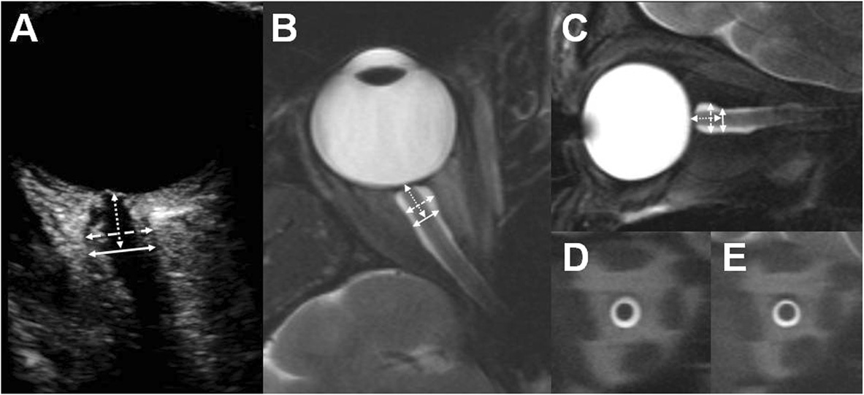
MRT AND ULTRASOUND: REPRODUCIBILITY
Correlation analysis of ultrasound and MRI results:
Very good correlation at 3 mm depth (r = 0.72, p = 0.002, mean differences < 5%)
Bäuerle J et al. BMC Neurol 2013
Notes:
Diagnostische Wertigkeit der Methode und der beschriebenen Messentechnik mit einer Referenzmethode
akzeptable Übereinstimmung zwischen 2 Methoden

Slide 20
MEAN VALUES OF ONSD IN CHILDREN
Upper limit of normality for children: 4.0 mm in infants aged less than 1 year
Older children: 4.5 mm
NEWMAN WD,. Br J Ophthalmol 2002;86:1109–13, BALLANTYNE J,ET AL . Clin Radiol 1999;54:740–2, HELMKE K, HANSEN HC. . PediatrRadiol 1996;26:706–10.

Slide 21
DIFFERENT PROBES AND FREQUENCIES

Slide 22
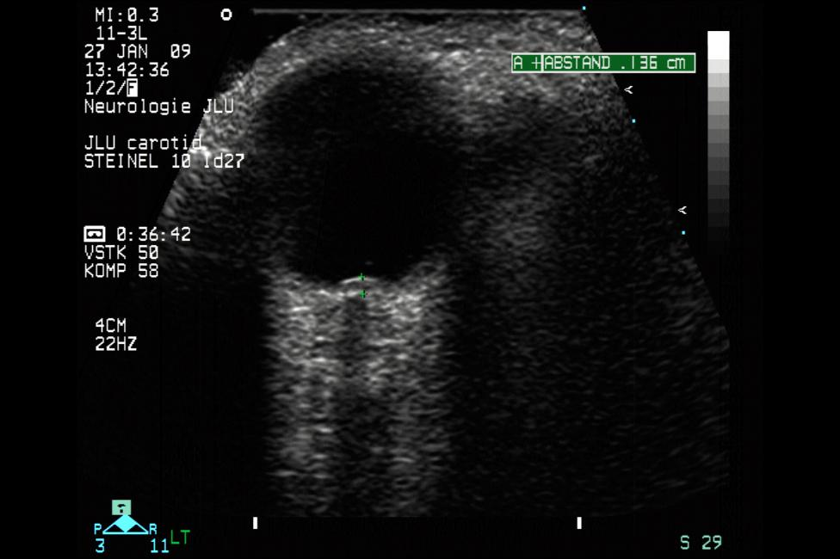
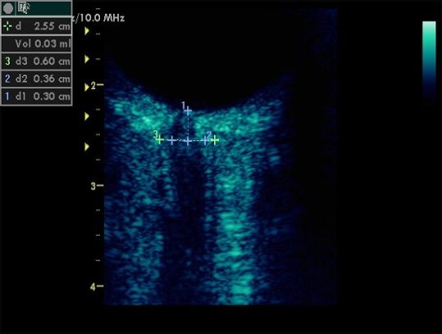
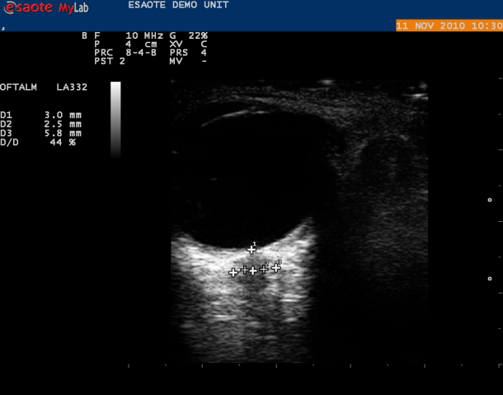
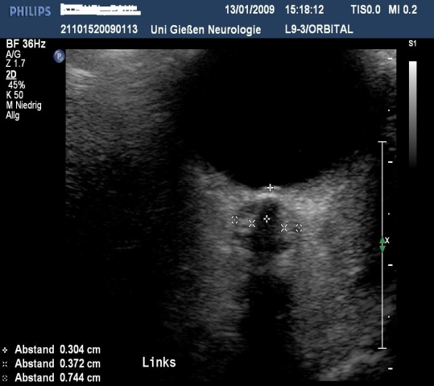
DIFFERENT PROBES?

Slide 23
ULTRASOUND TECHNIQUES TO MEASURE THE OPTIC NERVE SHEATH: IS A SPECIALIZED PROBE NECESSARY?
Intraobserver and interobserver reliability among 3 emergency physicians using 3 different imaging protocols. 3 measurements of the right eye OSND with both 10-5 and 13.5 MHz probes using the axial technique (experiment 1). The OSND was measured with the 10.5 using the axial technique and the intracavitary 8.5 MHz using the coronal technique (experiment 2)
Comparable precision and inter-observer reliability can be achieved.
Large values when using the 10-5 MHz probe suggest different cut-off thresholds for normal upper limits.
23
Shah S et al Med Sci Monit, 2009: 15(5): MT 63-68
Notes:
SONDE PICCOLE POSSONO GARANTIRE UNA MIGLIORE RISOLUZIONE DELL´IMMAGINE DI STRUTTURE SUPERFICIALI COME L´OSND
IN + UTLIZZATE DELLE IMMAGINI CORONALI CHE EVITANO ALCUNI DEGLI ARTEFATTI CAUSATI DAL CRISTALLINO CHE POSSONO ALTERARE LA ACQUISIZIONE DELL´IMMAGINE SU UNA VISIONE ASSIALE

Slide 24

Nobil natura è quella
Che a sollevar si ardisce
Gli occhi mortali incontra
Al comun fato, e che con franca lingua[...]
Confessa il mal che ci fu dato in sorte.

Slide 25
PAPILLENOEDEMA

Slide 26
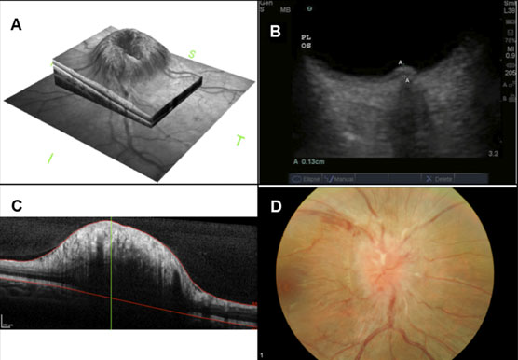
PAPILLENOEDEMA
B, D: Ultrasound and Fundus
A, C:
papilloedema
Optical
coherence tomography
Teismann N et al. Acad Emerg Med 2013 J Ultrasound Med 1995;14:91-6.

Slide 27
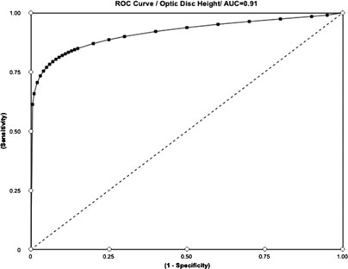
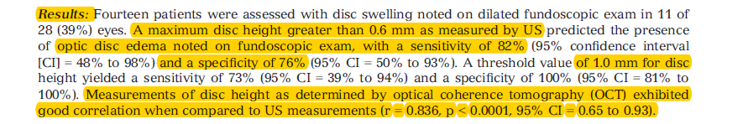
POINT OF CARE OCULAR ULTRASOUND TO DETECT OPTIC DISC SWELLING
Point-of-care Ocular Ultrasound to Detect Optic Disc Swelling 2013

Slide 28
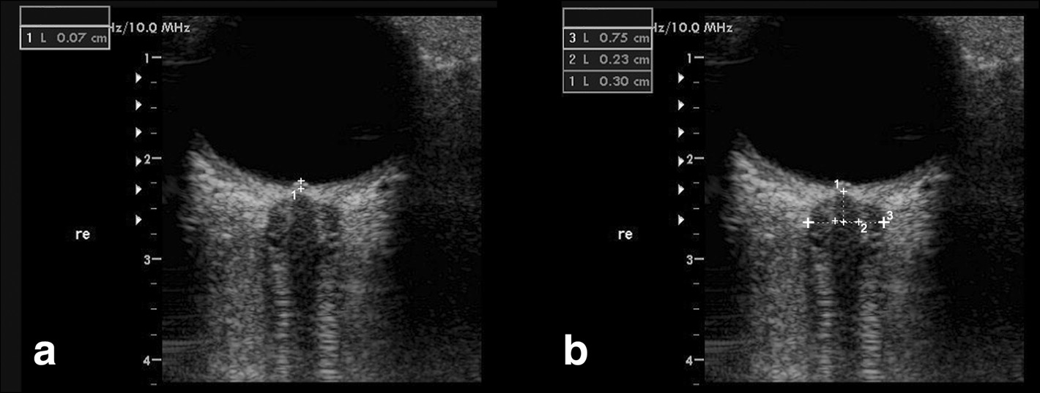
OCULAR ULTRASOUND
ODE
ONDS
OND
(1)ODE fundus and the dome of the papilla
OND distance inside the pia mater (2–2)
ONSD inside the dura mater (3–3).
Lochner et al BMC Neurology 2016
Notes:
The presence of papilledema is assessed measuring the distance between the fundus and the dome of the papilla
The first caliper must be placed on the uppermost part of the swollen disc and the second caliper on the strongly reflecting line, which represents the lamina cribrosa.
keine Äthiologie des Papillenödems; severe disc edema can occurr in the absence of ICP elevation
MS, sarcoidose, lymphoma, infections, neurosyphilis, malignant hypertensive retinopathy
ICP korrelieren signifikant miteinander: Der N.opticus ist von Subarachnoidalraum in Form seiner Nervenscheide umgeben und so ständig in Kontakt mit dem Liquorsystem (Bäuerle et al, 2011)
ICP korrelieren signifikant miteinander: Der N.opticus ist von Subarachnoidalraum in Form seiner Nervenscheide umgeben und so ständig in Kontakt mit dem Liquorsystem (Bäuerle et al, 2011)
→ Methode zur nichtinvasiven Hirndruckdiagnostik
Die TOS weist eine Sensitivität von 96 % für einen erhöhten ICP auf und eine Spezifität von 94% bei Werten über 20mmHg (Rajajee V, 2011)
→ Methode zur nichtinvasiven Hirndruckdiagnostik
Die TOS weist eine Sensitivität von 96 % für einen erhöhten ICP auf und eine Spezifität von 94% bei Werten über 20mmHg (Rajajee V, 2011)
ICP elevation does not cause disc swelling in acute setting
Papilledema impaired retrograde axoplasmic flow within the fibers of the optic nerve hours to day todevelop

Slide 29
CENTRAL RETINAL ARTERY AND VEIN

Slide 30
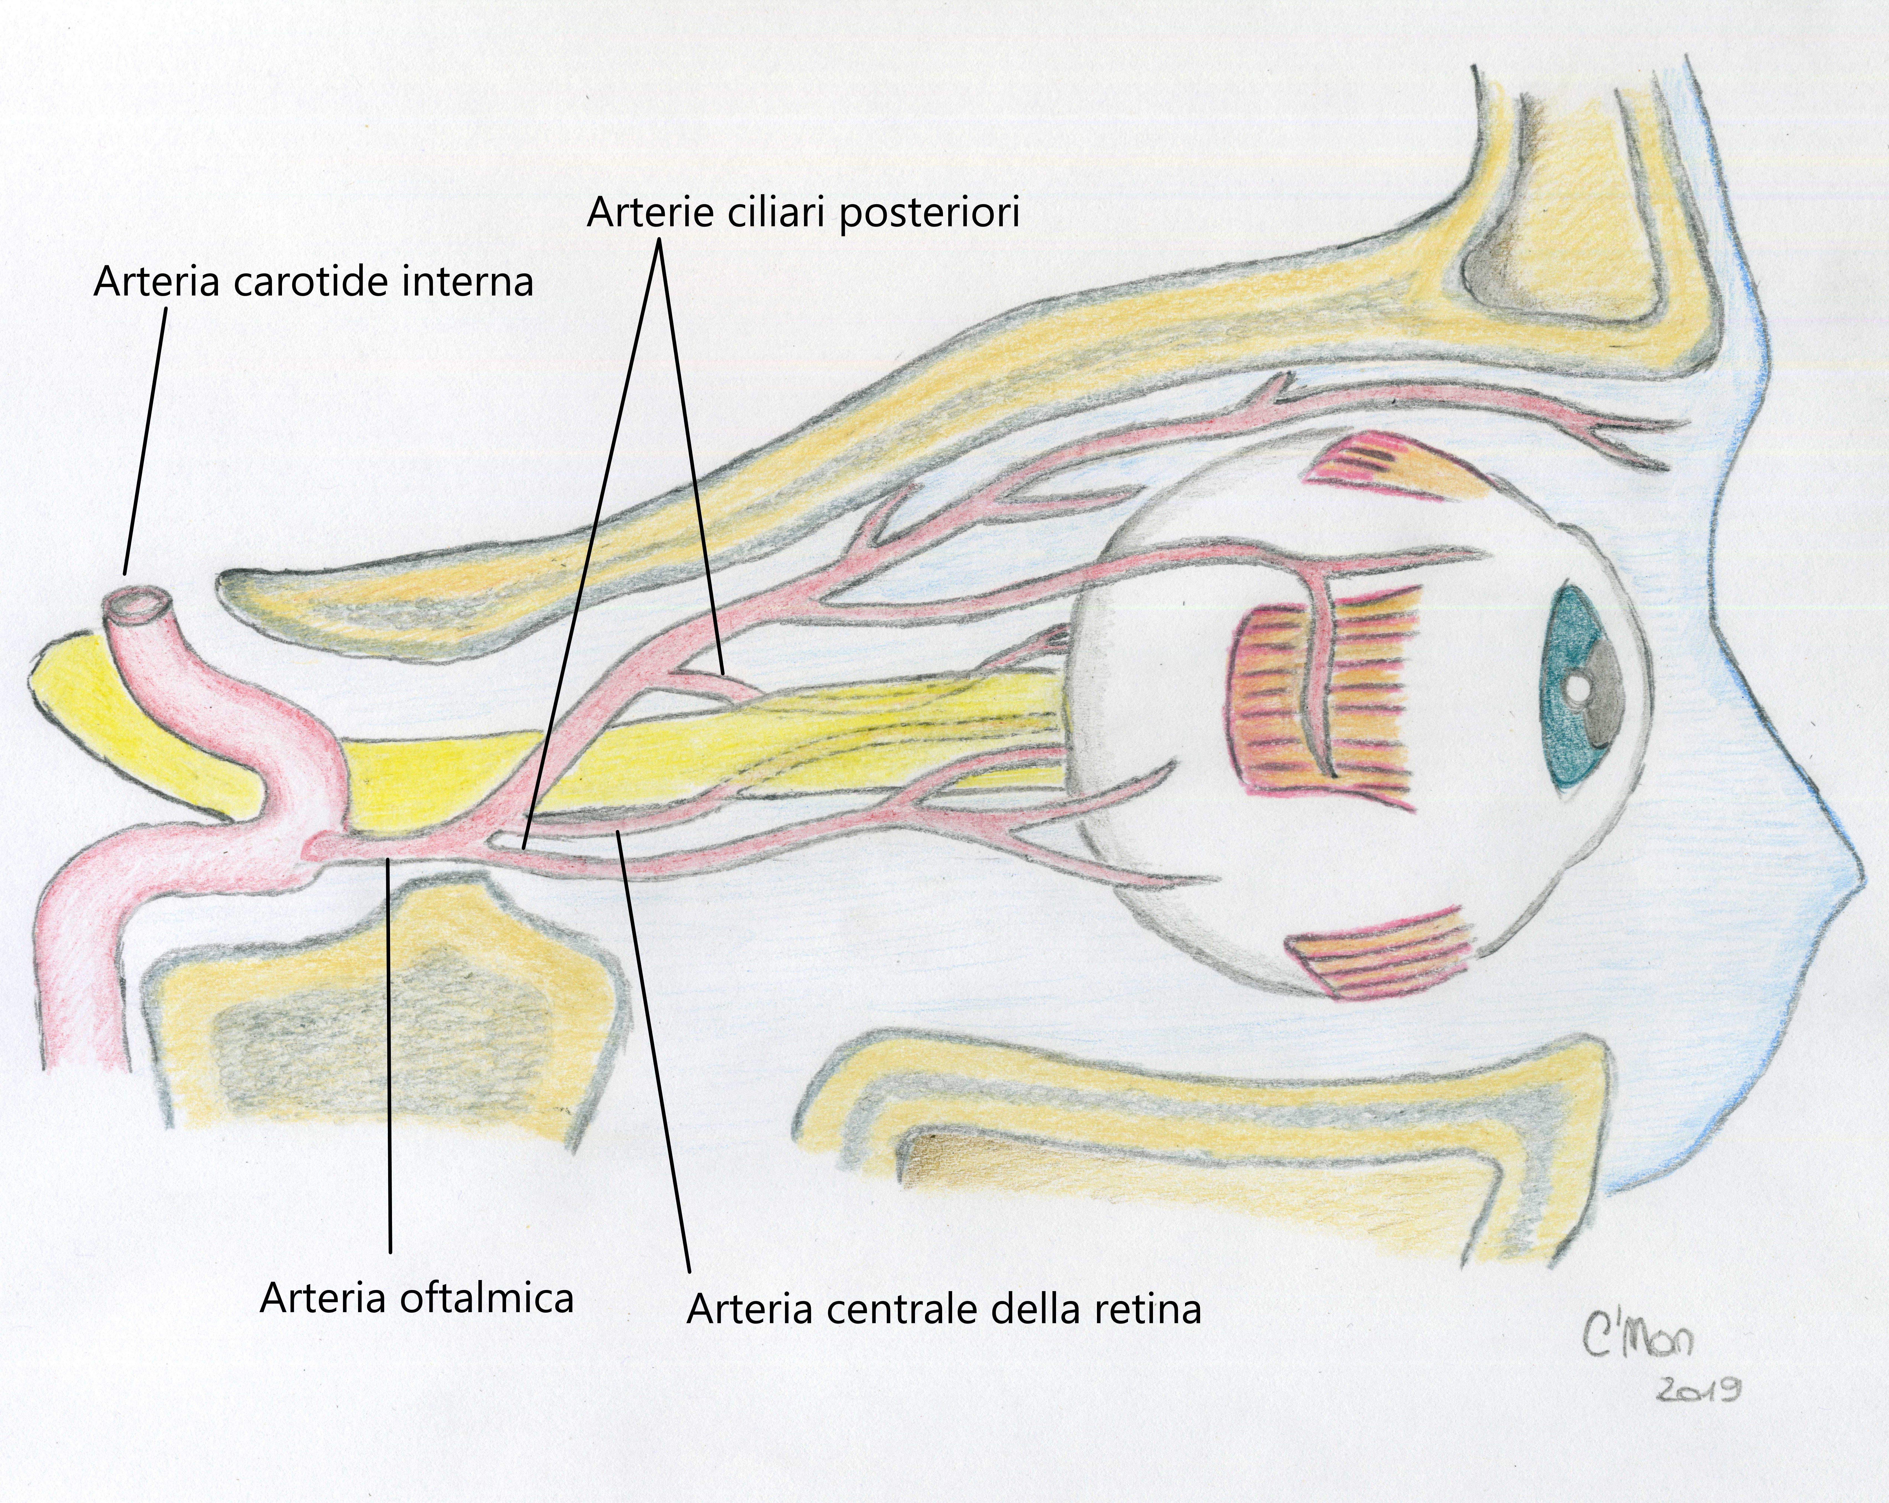
CENTRAL RETINAL ARTERY AND VEIN ANATOMY

Slide 31
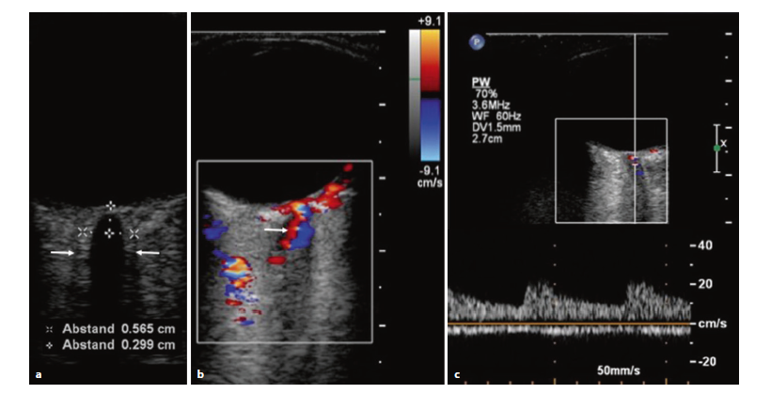
CENTRAL RETINAL ARTERY AND VEIN
Low pulse repetition frequency (PRF) Angle flow, Correction was applied, varying between 0° and 45; gate size 1.5 mm, Peak systolic velocity, end Diastolic velocity
Resistive index (RI) maximum and minimum velocity (v-max, v-min), retinal venous pulsation (RVP)
Baxter et al. J Ultrasound Med 1995;14:91-6.

Slide 32
MAXIMUM SYSTOLIC BLOOD FLOW VELOCITIES IN ORBITAL VESSELS
Orbital vessel | Mean ± SD Blood Flow, cm/s (Range)
Central retinal artery | 10,3 +/- 2,1 (6,4 – 17,2)
Central retinal vein | 2,9 +/- 0,73 (1,9 – 5,4)
Ophthalmic artery | 31,4 +/- 4,2 (23,5 – 39,8)
Posterior ciliary artery | 12,4 +/- 4,8 (1,4 – 22,7)
Orbital vessel Mean ± SD Blood Flow, cm/s (Range) from Lieb et al.

Slide 33
Ultrasonography Monitoring using Retinal Vessels in Patients with Cerebral Hemorrhage
Naldi et al.J Neuroimaging 2019;394-399.

Slide 34
Recanalized central artery with formation of a stenosis at the level of the spot signs
Bernhard Widder · Gerhard F. Hamann Duplexsonographie der hirnversorgenden Arterie, 7. Auflage
Notes:
Amaurosis fugax zu einem Zentralarterienverschluss mit persistierendem Sehverlust am linken Auge

Slide 35
.
DYNAMIC ULTRASONOGRAPHIC MEASUREMENT
Notes:
Papilledema is optic disc swelling that is secondary to elevated intracranial pressure
Papilledema is optic disc swelling that is secondary to elevated intracranial pressure
Papilledema almost always presents as a bilateral phenomenon and may develop over hours to weeks
Optic nerve infectious, infiltrative, or inflammatory etiologies
Papilledema almost always presents as a bilateral phenomenon and may develop over hours to weeks
Optic nerve infectious, infiltrative, or inflammatory etiologies

Slide 36
Dynamic ultrasonography
measurement
ONSD changes in patient with spontaneous intracranial hypotension from supine to upright body position. a Supine position. B Orthostatic position.
Neurological Sciences https://doi.org/10.1007/s10072-019-04015-x

Slide 37
OPTIC NERVE SHEATH RESPONSES TO PRESSURE VARIATIONS
Hansen HC Acta Ophthalmol. 2011: 89: e528–e532

Slide 38
NON-INVASIVE ICP ESTIMATION METHODOLOGICAL ASPECTS
Close correlation (r = 0.78) between CSF pressure and ONSD
Response varied between subjects (0.019–0.071 mm/mm Hg)
Clinical settings should perform serial ONSD measurements and always aim for a trend
analysis
The measurement should be taken at 3 mm behind the globe
ONSD monitoring is a promising but not easy-to-interpret
We attend an improvement of ultrasound techniques

Slide 39

thank you
08/10/2021
Piergiorgio Lochner
39
Piergiorgio.lochner@uks.eu

